Slide 1
UGRJ Author Workshop

Slide 2
Meet the Leadership Team!
Visit our website
https://engage.ucr.edu/research/journal
Notes:
Leadership team will be the author’s main point of contact. Each submission will be assigned 1 EIC, 1 AEIC, and 1 copy editor.
Co-Editor-in-Chiefs will email the reviewed submissions back to author
Associate Editor in Chiefs will be the main point of contact for questions during the review process. Any questions regarding your submission or feedback form from the review team should be sent to them.
Copy Editor will be the next contact if paper is accepted. They do a final pass on submissions, checking for grammar and overall clarity in the paper.

Slide 3
Submission Requirements
Name the file as “First Submission - Title” (Future revisions should include the Submission #)
References: Follow the citation styles of your discipline (ex: MLA, APA, CSE, etc…) Please work with your faculty mentors to determine which should be used
Margins must be 1-inch on all sides
Abstract must be single spaced
Article text must be double spaced
Articles must be submitted as a Word document
Submission manuscript will require approval by your faculty mentor
Document size cannot exceed 5 MB
The maximum length of a submission cannot exceed 12 pages; including all figures, tables, illustrations, footnotes, citations, and references. Does not include the abstract or author information
Notes:
Pretty self explanatory -> just go through these requirements

Slide 4
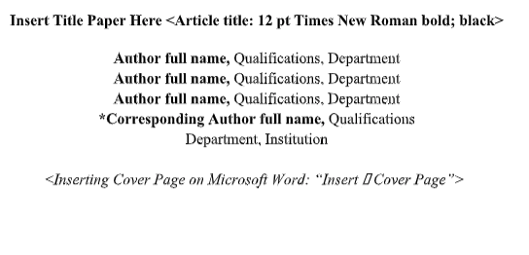
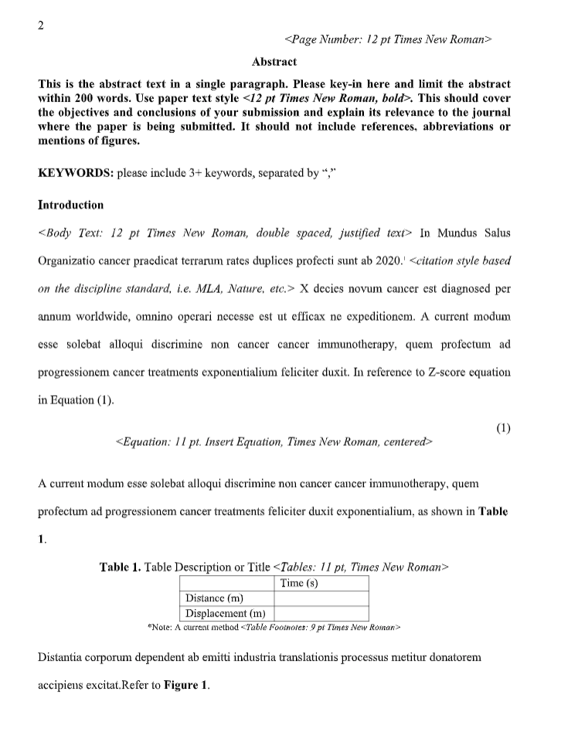
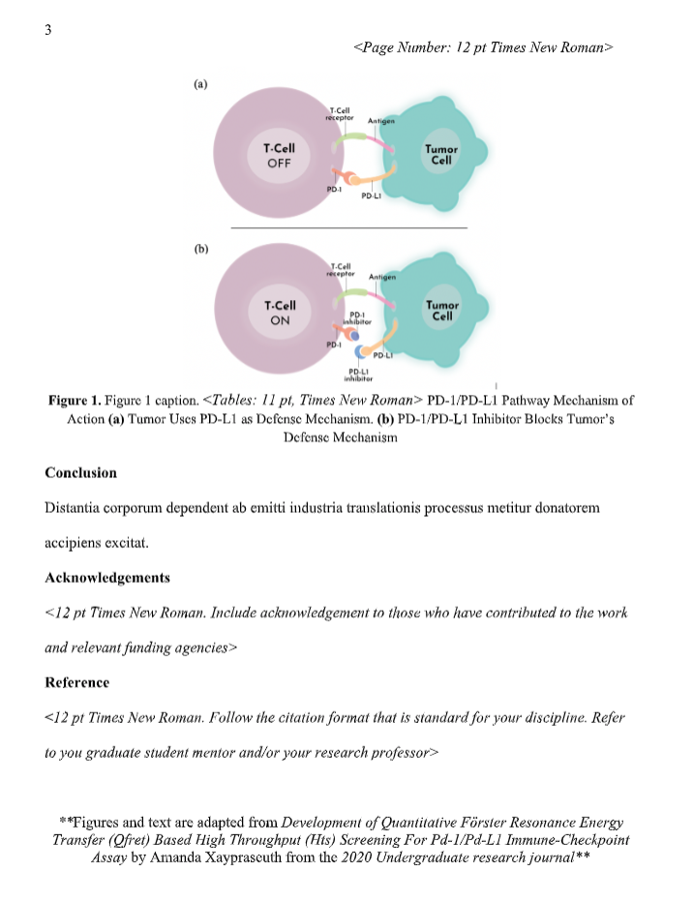
Paper Format
Note: Sections in paper (e.g. Intro, Results, Methods, Conclusion) will depend on discipline
Fall Deadline: October 16, 2020 @ 5pm
Winter Deadline: January 8, 2021 @ 5pm
Spring Deadline: April 2, 2021 @ 5 pm
Notes:
An example template using a submission from last year’s journal. Use this example when formatting your own submission to smoothen the overall process. During review, paper format won’t necessarily be a factor when judging the article but, following this template will reduce a lot of work in the future, post-acceptance. Additionally, each quarter’s deadline is listed here.
The following example template can be found on the UGRJ website. Scroll down -> Submitting an article -> Journal Formatting Requirements
The ideal structure of any article will depend on the discipline. Please consult with your faculty mentor to determine the paper structure that is most appropriate for your submission. It is recommended that all submissions contain the following elements:
Title -- Place the title of your article at the top of each page, followed by the names of the student author(s) and the faculty mentor(s).
Authorship is very specific. It is an explicit way of assigning responsibility and giving credit for intellectual work. In order to properly assign authorship credit, please follow these guidelines.
One author should take primary responsibility for the work as a whole. The Primary Author is responsible for submission.
Everyone who is listed as an author must have made a substantial, direct, intellectual contribution to the work. For example, they should have contributed to the conception, design, analysis and/or interpretation of data, as well as to the actual writing of the article.
Please list authors in order of contribution. You are encouraged to discuss this with the team members prior to submission. The order that you provide in this submission is the order the authors will be listed.
All authors should participate in the editing process by reviewing drafts and approving the final version before publication.
Abstract --A single paragraph containing no more than 250 words. An abstract briefly defines the problem, purpose, or specific topic addressed by the research. It briefly indicates the methods and/or approach taken in inquiry and summarizes results or conclusion. It should be written in grammatically correct, logically connected sentences. It should be understandable by any audience with reasonable knowledge of its field. The abstract should not contain any charts, tables, graphs, figures, or spreadsheets. The abstract must be single spaced.
Keywords -- 6-8 keywords relevant to the topic
Introduction – Enough background information for any reader to understand the position taken. Define field-specific terms here.
Methods/Methodology - A logical, step-wise process defined enough such that anyone in the field can replicate your results with accuracy.
Results/Findings
Discussion
Acknowledgments
Works Cited / References

Slide 5
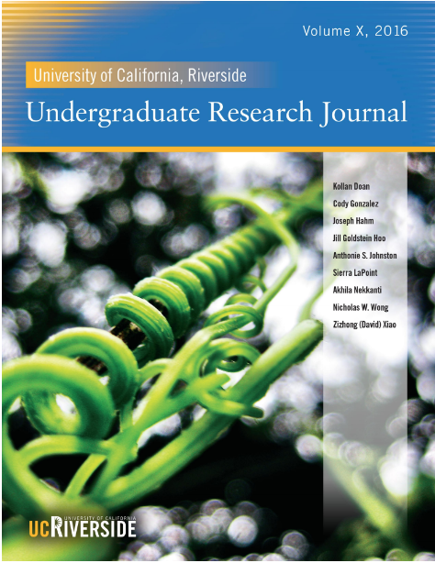
Cover Artwork Submissions
-Artwork can be about anything
-Submit on the Journal website
-Deadline for cover artwork
- January 2 at 5 pm
- April 1, 2021 at 5 pm
Notes:
Artwork is conventionally any photograph of your choice. Submissions will be accepted from any student (regardless of whether they submit an article for the journal or not)
-Specific details about the cover artwork format can be found on the ugrj website

Slide 6
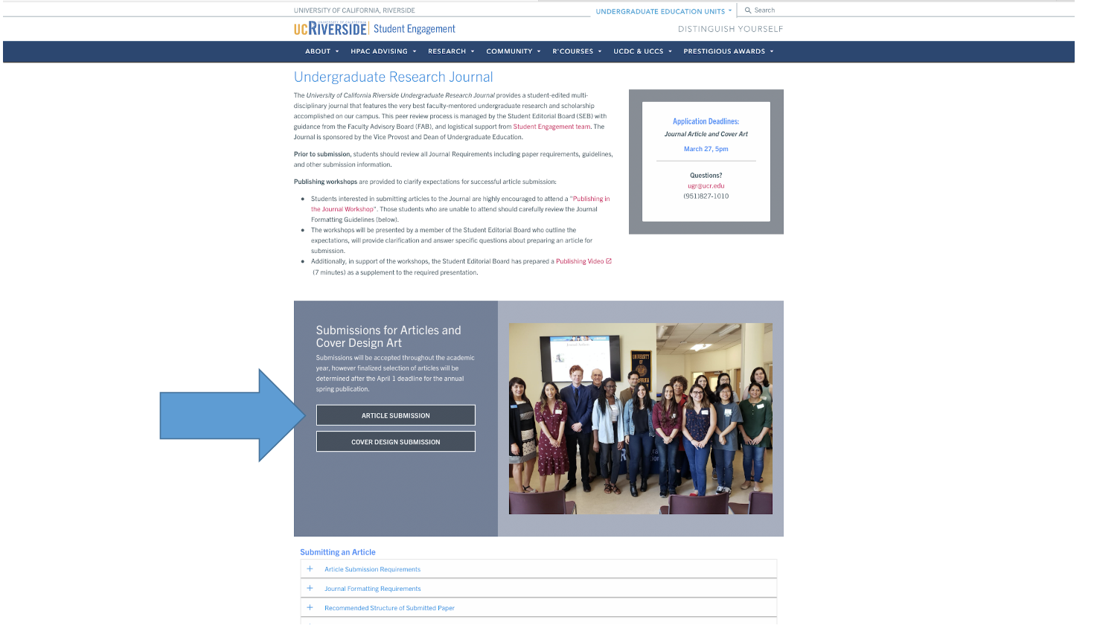
Notes:
To submit articles, head over to the undergraduate research journal website and click the following. You will be prompted to fill in some contact information for yourself, your PI/Faculty mentor, and your advising graduate student. Please also keep in mind that once you submit, your faculty mentor will be required to accept and approve your submission. This approval will be simply a response to an email that the UGRJ will send out upon submission so please, try to submit articles as early as possible before the deadline and make sure that your faculty mentor knows to expect an email once you do submit.

Slide 7
Review Process
Author Edits (1 Week)
Author Edits (1 Week)
Leadership Reviews
Article Submission and Review Team Assignment
1st Round of Editor Reviews
2nd Round of Editor Reviews
3rd Round of Editor Reviews (Final)
Start: Sunday 5 pm
Deadline: Friday 5 pm
Start: Sunday 5 pm
Deadline: Friday 5 pm
Start: Sunday 5 pm
Deadline: Friday 5 pm
Notes:
Once the article is submitted, it will enter the review process as such. *Briefly describe/summarize the editing timeline*

Slide 8
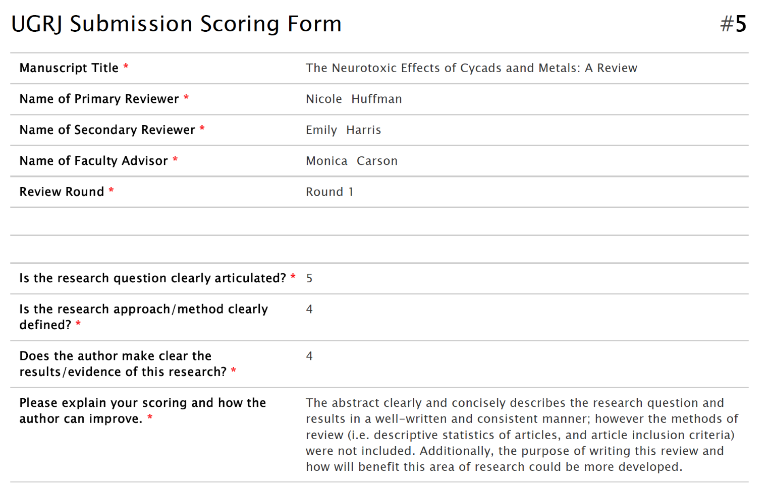
Place your screenshot here
UGRJ Scoring

Slide 9
Section Breakdown
Item | Point Value
Abstract | 15
Article Body | 50
References and Citations | 10
Overall Consideration | 25
 | 100
Notes:
The 4 general categories that will be used to review student’s paper.

Slide 10
Point System
5
Highly developed; compelling and well written; thorough; consistently formatted
4
Needs only minor revisions; sufficiently written and developed; rarely vague or confusing; very few inconsistencies
3
Needs moderate revisions and/or further development, but still mostly clear to reader; occasionally vague, confusing, or inconsistent
2
Needs some major revisions and/or to be much more developed; raises major questions for reader; often confusing, misleading, or inconsistent
1
Under-developed; needs sweeping revisions or possible re-write; leaves reader with more questions than answers; confusing, misleading, or inconsistent throughout
0
Item in question is completely lacking from submission

Slide 11
Section Questions
Abstract
Is the research question clearly articulated?
Is the research approach/method clearly defined?
Does the author make clear the results of the research?
Article Body
Does the author clearly state the research question and explain its significance?
Does the author provide sufficient background info; enough to establish his/her position for the reader?
Does the author make clear why the research is needed and/or its potential to its field?
Does the author thoroughly explain the material(s) and method(s) to answer the research questions?
Does the author explain the methodology?
Are the research results explicitly stated and thorough?
Does the author make clear how these results relate to the original research questions?
Does the author convey the implication and impact of these findings?
Does the author relate to other work and/or suggest possible directions for further study?
References and Citations
Has the author compiled a relevant and sufficient list of references?
Are the references and citations formatted correctly to the discipline.
Overall
Rate the author’s use of: spelling and grammar, clarity of the argument developed, the author’s use of in-text citations.
Does the author convince you that his/her questions and results are significant/was the argument successful?

Slide 12
Review Recommendation
Accept Everything is perfect (even grammar and spelling) | Accept pending minor revisions Some sections need little improvement, and there are some small grammar mistakes that need to be fixed
Revise and resubmit (major revisions required) Several sections need to be rewritten, and grammar or spelling needs significant improvement | Reject with possible resubmission The article does not meet the standards of the Journal, and any necessary revisions cannot be made within the required timeframe. The author may decide to substantially revise or rewrite and consider resubmission in the following quarter.

Slide 13
Notes on Scoring
The overall score (100) is intended as a guide and therefore there is not a solid score cutoff for a given review recommendation (e.g. Acceptance)
Reviewers will focus on content; although grammar is a small consideration in the point system, consistent and proper grammar will definitely help

Slide 14
Online Based Research
Research may be limited for students due to COVID-19; however,there are still plenty of ways for students to write and publish academic articles in the UGRJ even if they normally perform research on campus:
Meta-analysis
Using previous data from your lab
Graduate Student Assistance
Remote work
In general, make sure to consult your faculty mentor and ask if they have any projects you can work on and write an article for
Notes:
Meta-analysis- a statistical approach to analyzing current trends in a given research field/topic. Use statistics to observe common directions and findings within a field and predict where it might lead. (Think review paper but using statistics to form an actual methods, results and discussion section.
Previous data from lab- perhaps your faculty mentor has old data and/or projects that they have yet to manipulate etc.
Graduate student assistance- depends on the standard practice of your lab, but in some cases if your project is pertinent and close enough to a grad student’s own project, you and your faculty mentor may ask the graduate student to assist you by performing experiments you design, followed by data manipulation by you.
Overall: Students should first and foremost, contact their faculty mentor and express their interest in submitting an article. The above examples are simply ideas that students might be able to propose should their mentor not have any immediate ideas or projects for their article. In general, always contact the faculty mentor.

Slide 15
THANKS!
Questions?
ugr@ucr.edu

